Slide 1
SQL Functions
Submitted By
Maimoona Khilji

Slide 2
What is SQL?
SQL stands for Structured Query Language.
A computer language for:
Storing data
manipulating data
retrieving data
SQL is the standard language for Relational Database System.

Slide 3
Why SQL?
SQL is widely popular because it offers the following advantages:
It is standard language.
It is easy to understand.
Queries are short.
It allows user to describe, define, manipulate and drop the data.

Slide 4
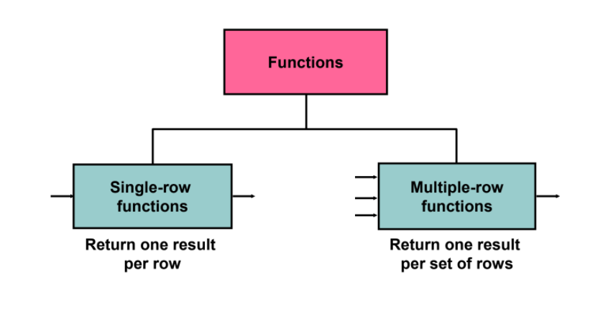
Functions in SQL

Slide 5
Single-row Functions

Slide 6
Single-row Functions
Single row functions are those function that give one result per row.
The single row functions are:
Character Functions
Number Functions
Date Functions

Slide 7
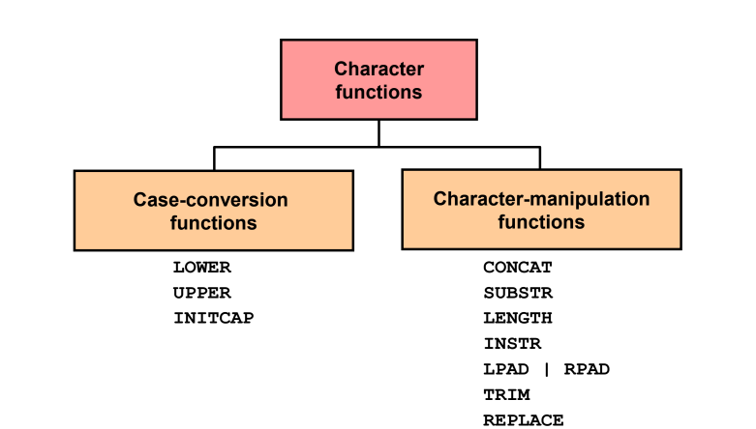
Character Functions

Slide 8
Case-Conversion Functions
These functions convert the case for character strings:
Syntax:
SELECT column1, column2, ... FROM table_name Where Function(column) = value;
Function | Result
LOWER('SQL Course') | sql course
INITCAP('SQL Course') | Sql Course
UPPER('SQL Course') | SQL COURSE

Slide 9
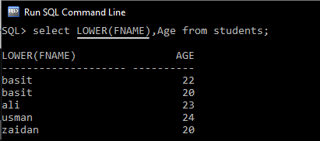
Case Conversion - LOWER

Slide 10
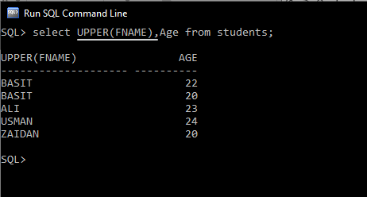
Case Conversion - UPPER

Slide 11
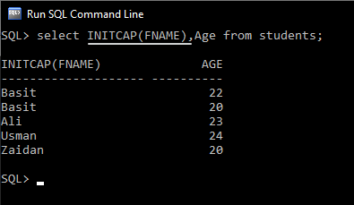
Case Conversion - INITCAP

Slide 12
Character-Manipulation Functions
These functions manipulate character strings:
Syntax:
SELECT column1, Function(column2) , ... FROM table_name Where Function(column)= value;
Function | Result
CONCAT('Hello', 'World') | HelloWorld
SUBSTR('HelloWorld',1,5) | Hello
LENGTH('HelloWorld') | 10
INSTR('HelloWorld', 'W') | 6
LPAD(salary,10,'*') | *****24000
RPAD(salary, 10, '*') | 24000*****
REPLACE ('JACK and JUE','J','BL') | BLACK and BLUE
TRIM('H' FROM 'HelloWorld') | elloWorld

Slide 13
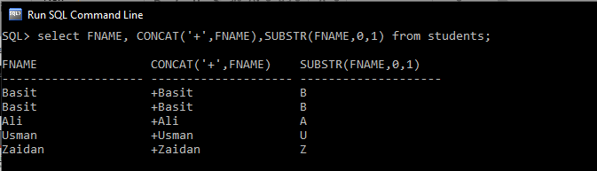
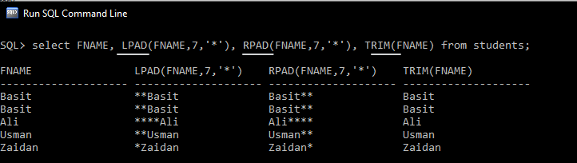
Character-Manipulation Functions

Slide 14
Number Functions
ROUND: Rounds value to a specified decimal
TRUNC: Truncates value to a specified decimal
MOD: Returns remainder of division
Syntax:
SELECT column1, Function(column2) , ... FROM table_name Where Function(column)= value;
Function | Result
ROUND(1.268, 2) | 1.27
TRUNC(1.268, 2) | 1.26
MOD(5, 2) | 1

Slide 15
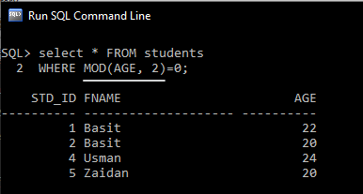
Number Functions-MOD

Slide 16
Date-Manipulation Functions
Function | Result | Use of function | Result
MONTHS_BETWEEN | Number of months between two dates | MONTHS_BETWEEN ( '01-SEP-95‘ , '11-JAN-94‘ ) | 19.6774194
ADD_MONTHS | Add calendar months to date | ADD_MONTHS (‘31-JAN-96',1) | ‘29-FEB-96'
NEXT_DAY | Next day of the date specified | NEXT_DAY ('01-SEP-95','FRIDAY') | '08-SEP-95'
LAST_DAY | Last day of the month | LAST_DAY ('01-FEB-95') | '28-FEB-95'
ROUND | Round date | ROUND ( '25-MAY-93 ‘ , 'YEAR') | ‘01-JAN-94'
TRUNC | Truncate date | TRUNC ( '25-MAY-93 ‘ , 'YEAR') | ‘01-JAN-93'

Slide 17
Multiple-row Functions

Slide 18
Multiple-row Functions
Multiple row functions are those function that give one result per row.
Multiple row functions are Group functions.
Group functions operate on sets of rows to give one result per group.

Slide 19
GROUP Functions
Types of Group COUNT
MAX
MIN
STDDEV
SUM
VARIANCE
Syntax:
SELECT group_function (column), ...
FROM table
[WHERE condition]
[ORDER BY column];

Slide 20
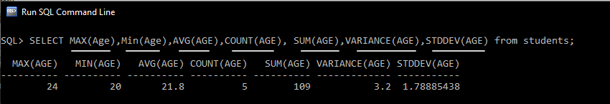
GROUP Functions

Slide 21
Grouping rows
Grouping rows:
GROUP BY clause
HAVING clause

Slide 22
GROUP BY
Creating Groups of Data using GROUP BY Clause.
You can divide rows in a table into smaller groups by using the GROUP BY clause.
Syntax:
SELECT column, group_function(column)
FROM table
GROUP BY column;

Slide 23
Grouping by More than One Column
Using the GROUP BY Clause on Multiple Columns
Syntax:
SELECT column1, column2, group_function(column)
FROM table
GROUP BY column1, column2;

Slide 24
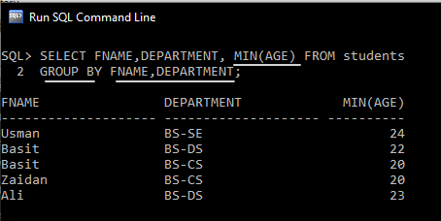
Grouping by More than One Column

Slide 25
Having clause
When you use the HAVING clause, the Oracle server restricts groups as follows:
Rows are grouped.
The group function is applied.
Groups matching the HAVING clause are displayed.
Syntax:
SELECT column, group_function(column)
FROM table
GROUP BY column
Having group_condition;

Slide 26
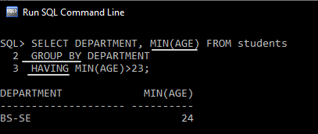
Having clause

Slide 27
CAST ( )
The CAST() function converts a value (of any type) into a specified datatype.
Syntax:
CAST (expression AS datatype(length));
SELECT CAST(25.65 AS varchar);

Slide 28
Questions
Which function can we use to get the date?
Getdate()
If we have to change the data type of column, which function we can use?
Cast()
Alter table name modify column name datatype;

Slide 29
THE END

